Slide 1
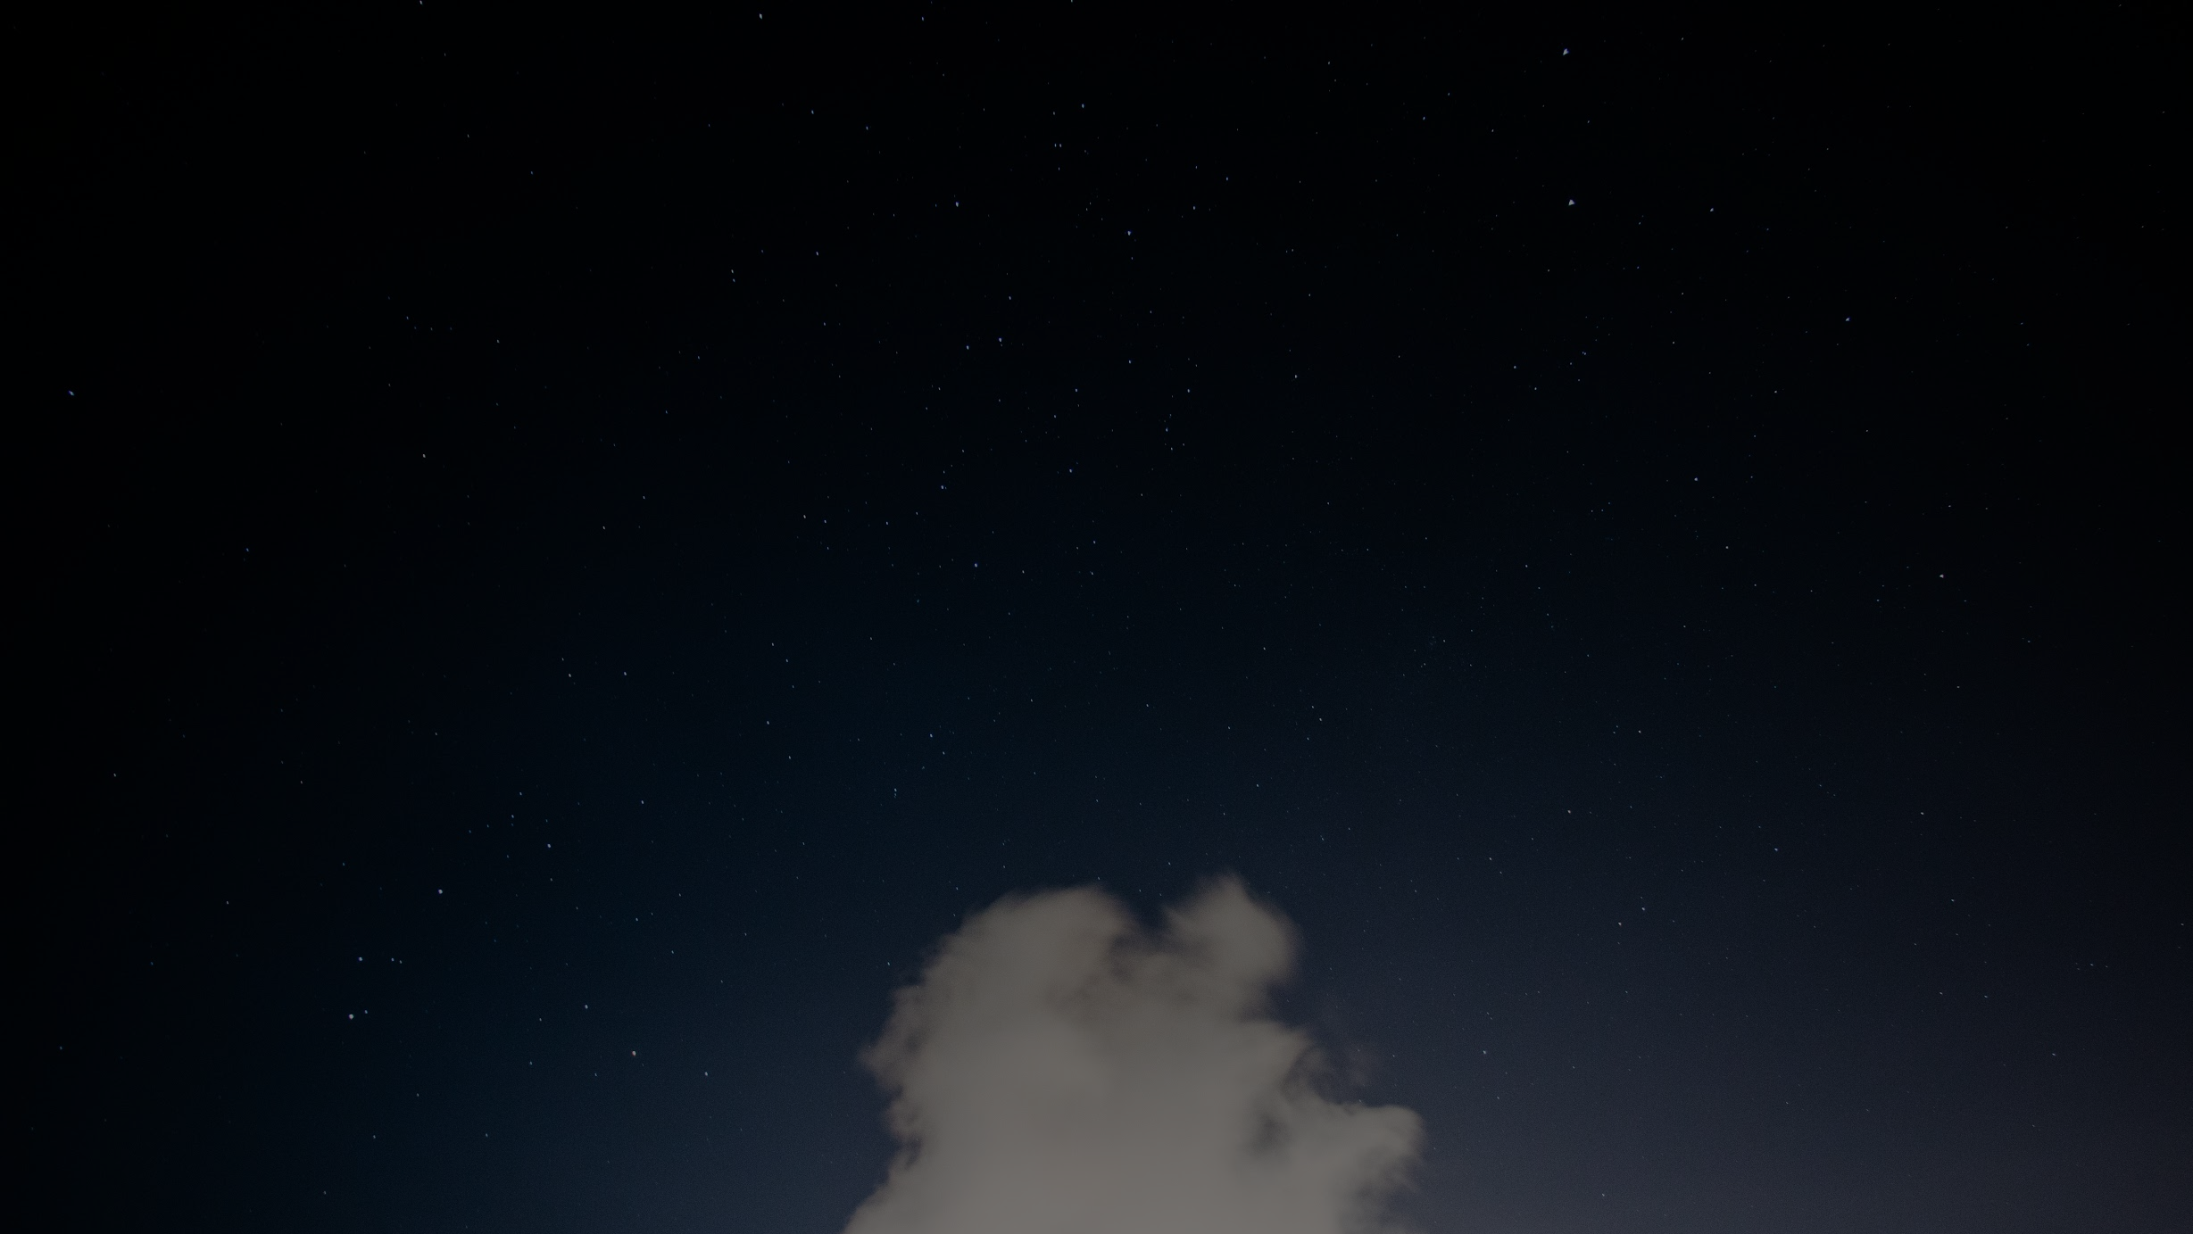
STELLARQUEST
Your Team Name Goes Here: Holy Coders
Team Members Names: Varsha P, Paayas P, Rahul Sreenivasan, Krithika S
Your Team Head’s Email Id Goes Here: varshaavvchennai@gmail.com

Slide 2
Motivation
The StellarQuest project is motivated by our innate desire to explore and understand the universe. Astronomy has captivated people for centuries, and there is still much to discover about the celestial objects that populate our cosmos.
By classifying stars, galaxies, quasars, and black holes, we gain insights into their physical properties and unravel the mysteries of the cosmos.
Using advanced deep learning techniques, the project creates an efficient and accurate system for classifying celestial objects, benefiting astronomers and researchers worldwide.

Slide 3
Motivation
The Hubble Space Telescope, launched in 1990, has provided countless breathtaking images and scientific data, fueling public interest in astronomy.
The Large Hadron Collider, a particle physics experiment, involves over 10,000 scientists and engineers, showing the collaborative nature of astrophysical research.
The development of machine learning techniques has significantly improved the accuracy of object classification in astronomy, making it an exciting field for technological advancements.
The Kepler Space Telescope has identified over 2,600 exoplanets, emphasizing the need for advanced tools to understand and categorize celestial objects.
Astronomical data from projects like the Sloan Digital Sky Survey (SDSS) continue to expand our knowledge of the universe, highlighting the importance of classification systems.

Slide 4
The Problem Statement
The current methods of classifying and understanding celestial objects lack efficiency and accuracy, hindering our ability to unravel the mysteries of the universe and gain deeper insights into its physical properties. There is a need for an advanced and reliable system that can effectively classify stars, galaxies, quasars, and black holes, enabling astronomers and researchers to explore and comprehend the cosmos more comprehensively. The goal is to develop a cutting-edge solution that enhances our understanding of the universe and its celestial objects.

Slide 5
Research
We embarked on the research by studying relevant publications, research papers, and real-life examples in the field of astronomy. This laid the groundwork for our project.
Our research underscored the importance of understanding the data, identifying machine learning problem types, selecting performance metrics, and defining machine learning objectives and constraints.
We also learned valuable practical skills in machine learning, encompassing data cleaning, preprocessing, model selection and optimization, and performance evaluation.

Slide 6
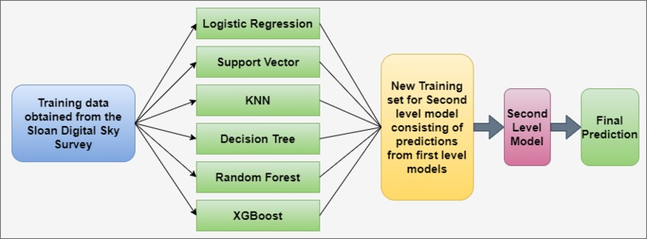
Our Product Architecture
The StellarQuest project utilizes a dataset of 100,000 space observations from the SDSS. Each observation is described by 17 features and a class column identifying stars, galaxies, and quasars. Machine learning algorithms like Logistic Regression, K-Nearest Neighbors, SVM, Decision Tree, Random Forest, XG Boost, and a Stacking Classifier are employed to create an efficient classification system.

Slide 7
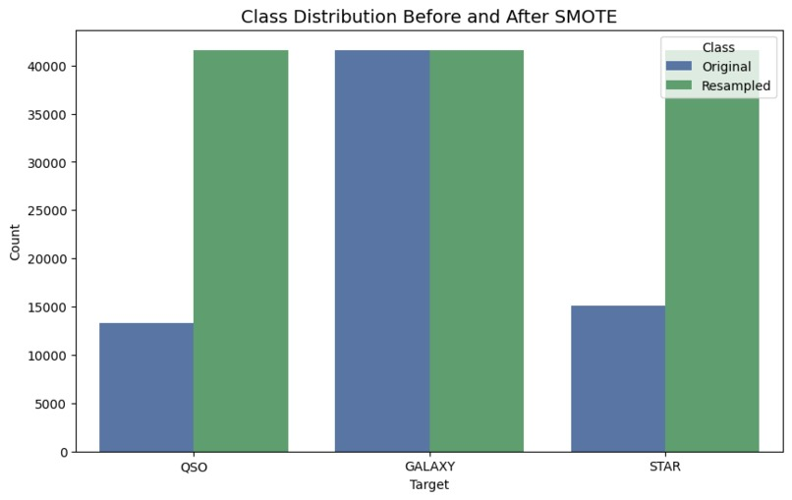
Experiment
Data / Results
Comparison of the SDSS dataset before and after applying the SMOTE data augmentation technique.

Slide 8
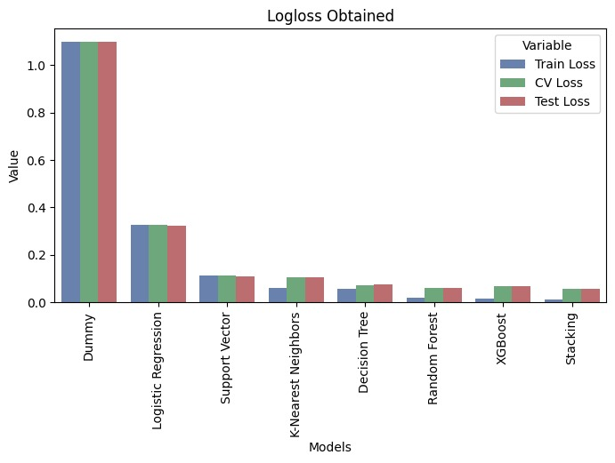
Experiment
Data / Results
The distribution of log loss for different models shows that the stacking approach outperforms the other models in terms of performance.

Slide 9
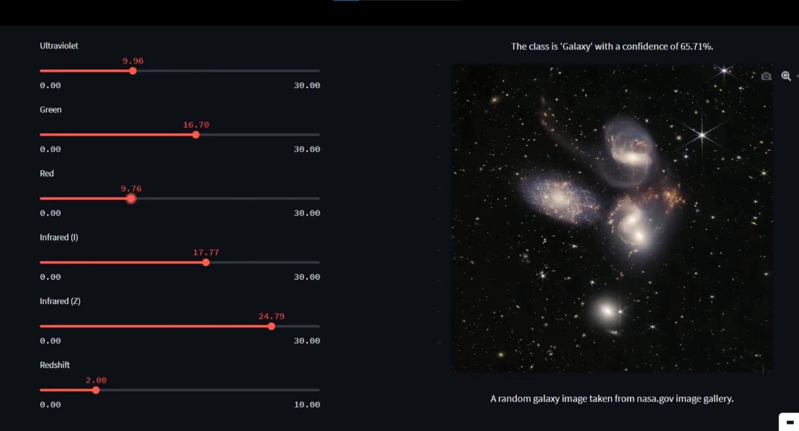
Experiment
Data / Results

Slide 10
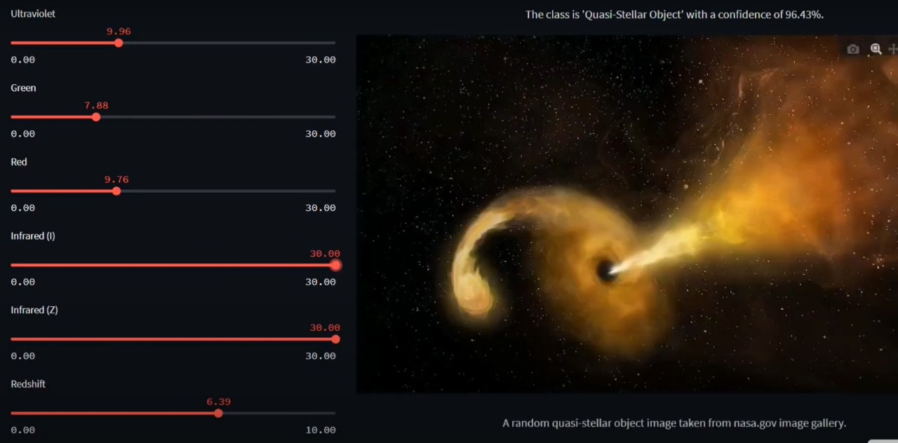
Experiment
Data / Results

Slide 11
Our discoveries
Understanding data: Learn key concepts like celestial sphere, celestial equator, photometric system, and redshift for better data comprehension.
Problem types: Identify the problem type to choose appropriate algorithms and techniques.
Performance metrics: Select metrics to evaluate model performance accurately.
Objectives and constraints: Define goals and constraints to optimize machine learning models.
Model selection: Choose models and techniques to improve accuracy and efficiency.
Feature engineering: Enhance model accuracy by selecting, extracting, and transforming relevant features.
Practical skills development: Gain hands-on experience in data cleaning, preprocessing, model selection, and performance evaluation.

Slide 12
Conclusion
In conclusion, the StellarQuest project represents a significant milestone in our journey to explore and understand the universe. By harnessing the power of machine learning and advanced deep learning techniques, we have developed a comprehensive classification system for celestial objects. This classification system allows us to gain valuable insights into the physical properties of stars, galaxies, quasars, and black holes, unraveling the mysteries of the cosmos. It not only enhances our understanding but also provides a valuable tool for astronomers and researchers worldwide. With the practical skills gained from this project, we are better equipped to handle complex machine learning tasks and contribute to the advancement of scientific knowledge. The StellarQuest project is a testament to the power of technology and our unwavering curiosity to explore the depths of the universe.

